Slide 1

Session Name:
Measures of Dispersion
Delivered By:
Vikash Singh

Slide 2

Learning Objectives
By the end of this session, you will be able to:
Understand dispersion concepts
Calculate Range, Variance, SD, CV, IQR
Detect outliers
Examples and quizzes

Slide 3
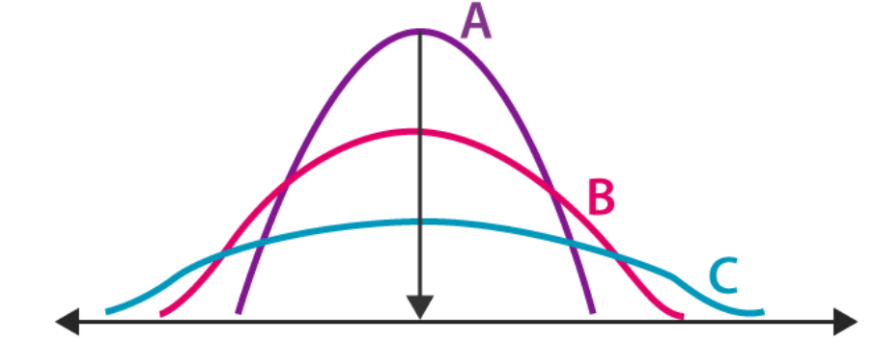
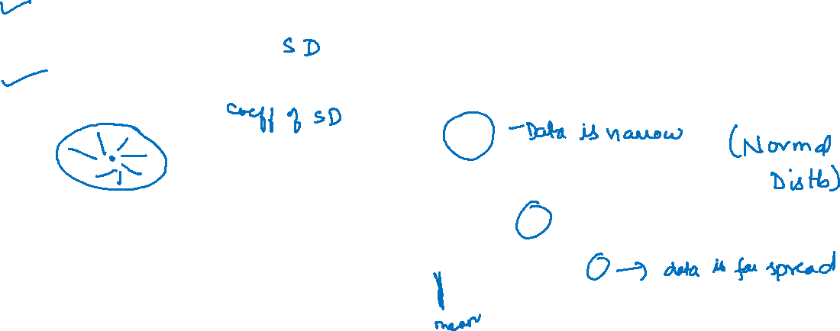
Dispersion
What is Dispersion?
Describes spread of data
Low dispersion: data points are tightly clustered
High dispersion: data points are widely spread

Slide 4
Importance of Dispersion
Complements central tendency
Helps assess risk, variability
Used in business, finance, data science

Slide 5
Five Number Summary
Minimum
First Quartile (Q1)
Median (Q2)
Third Quartile (Q3)
Maximum

Slide 6
Example Five Number Summary
Data: 5, 7, 8, 12, 14, 18, 21
- Min = ?
- Q1 = 7
- Median = ?
- Q3 = 18
- Max = ?

Slide 7
Measures of Dispersion
Measures of Dispersion
Range
SD
Variance
IQR

Slide 8
Range
Range is the difference between the largest (L) and the smallest value (S) in a distribution.
Coefficient of Range: Relative measure of range = (L-S)/(L+S)
Formula: Range = Maximum - Minimum
Example: Data: 15, 20, 25, 30, 35
Range = ?
Coefficient of Range = ?

Slide 9
Variance and Standard Deviation
Standard Deviation is a measure which shows how much variation (such as spread, dispersion, spread,) from the mean exists.
Variance is the square of standard deviation. The variance estimates the average degree to which each observation differs from the mean of all observations of the data.
Variance:
σ² = Σ(X-μ)² / N
Standard Deviation:
σ = √σ²

Slide 10
Class activity
Data: 10, 12, 14
Mean = ?
Variance ≈ ? (upto 2 decimal places)
SD ≈ ? (upto 2 decimal places)

Slide 11
Class activity
Data: 10, 12, 14
Mean = 12
Variance ≈ 2.67
SD ≈ 1.63

Slide 12
Coefficient of variation (CV)
Formula:
CV = (SD / Mean) × 100
Example:
Mean = 50, SD = 5
CV = (5/50)×100 = 10%

Slide 13
Interquartile Range (IQR)
Measures spread of middle 50%
Formula: IQR = Q3 - Q1
Less affected by outliers.

Slide 14
How to Calculate Q1 and Q3
Arrange data ascending
Q1 = (N+1)/4 th value
Q3 = 3(N+1)/4 th value
If decimal: interpolate between two values

Slide 15
IQR Example
Data: 5, 7, 8, 12, 14, 18, 21
Q1 = 2nd value = 7
Q3 = 6th value = 18
Q1 = (N+1)/4 th value
Q3 = 3(N+1)/4 th value

Slide 16







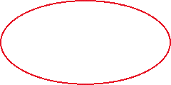

















IQR Example 2
Data: 2, 4, 6, 8, 10, 12, 14, 16. N = 8
Q1 = 9/4 = 2.25th value = 4.5 = 4 + (1/4 * 2) = 4.5
Q3 = 6.75th value = 13.5 = 12 + (3/4 * 2) = 13.5
Q1 = (N+1)/4 th value
Q3 = 3(N+1)/4 th value

Slide 17
¼ = 0.25
Data: 2, 4, 6, 8, 10, 12, 14, 16. N = 8
N = 8
N + 1 = 9
3 * (N=1) = 3 * 9 = 27
27/4 = 6.75
Q1 = 9/4 = 2.25th value = 4.5 = 4 + (1/4 * 2) = 4.5
Q3 = 6.75th value = 13.5 = 12 + (3/4 * 2) = 13.5

Slide 18
Detecting Outliers using IQR
Rule:
Lower Bound = Q1 - 1.5×IQR
Upper Bound = Q3 + 1.5×IQR
IQR = Q3 – Q1
Values outside bounds = Outliers

Slide 19
Outlier using IQR
Data: 5, 7, 8, 12, 14, 18, 21
Q1 = 2nd value = 7
Q3 = 6th value = 18
IQR = 11
Data: 5, 7, 8, 12, 14, 18, 21
How many outliers are there using IQR rule?
Rule:
Lower Bound = Q1 - 1.5×IQR = 7 – 1.5 * 11 = -9.5
Upper Bound = Q3 + 1.5×IQR = 18 + 1.5 * 11 = 34.5
How many values are below Lower Bound? 0
How many values are above Upper Bound? 0
Values outside bounds = Outliers

Slide 20
Outlier using IQR
Data: 5, 7, 8, 12, 14, 18, 21
Conclusion: if all the values of the data lies between lower bound and upper bound values, than it is evident that the data has no outliers.
No outliers found using bounds!

Slide 21
Real-World Applications
Quantitative Fields:
- Machine learning model errors
- Manufacturing quality control
Finance:
- SD for stock risk/volatility
- IQR for detecting abnormal returns

Slide 22
MCQ
Q1. Which of the following is NOT a measure of dispersion?
a) Range b) Variance c) Mean d) Standard Deviation
Q2. What does a high standard deviation indicate about a data set?
a) The data points are closely clustered around the mean b) The data has a perfect bell shape c) The data points are widely spread out from the mean d) The data has no variation

Slide 23
MCQ
Q1. Which of the following is NOT a measure of dispersion?
a) Range b) Variance c) Mean d) Standard Deviation
Q2. What does a high standard deviation indicate about a data set?
a) The data points are closely clustered around the mean b) The data has a perfect bell shape c) The data points are widely spread out from the mean d) The data has no variation

Slide 24
MCQ
Q3. Which measure of dispersion is calculated as the difference between the highest and lowest values?
a) Standard Deviation b) Interquartile Range c) Mean Absolute Deviation d) Range
Q4. The square of the standard deviation is known as:
a) Range b) Mode c) Variance d) Coefficient of Variation

Slide 25
MCQ
Q3. Which measure of dispersion is calculated as the difference between the highest and lowest values?
a) Standard Deviation b) Interquartile Range c) Mean Absolute Deviation d) Range
Q4. The square of the standard deviation is known as:
a) Range b) Mode c) Variance d) Coefficient of Variation

Slide 26
Session Summary
In this session, we have discussed about:
Understand dispersion concepts
Calculate Range, Variance, SD, CV, IQR
Detect outliers
Examples and quizzes

Slide 27

Happy Learning

